Slide 1
One Day Seminar on Real Estate Laws [Covering Income Tax, GST, RERA, RWA]
SIRC of ICAI
Important aspects of GST on Real Estate Transactions
CA Ganesh Prabhu
B.Com, MFM, F.C.A, DISA (ICAI)
Notes:
1

Slide 2
Agenda for Discussion
TIME LIMIT
SPECIAL ECONOMIC ZONE
RCM
Supply
Exemption
Definition
&
Terms
Construction Service
Goods
Service
WCS
Place of Supply
JDA
TOS
ITC
ROT

Slide 3
LIABILITY TO PAY TAX UNDER GST
Liability to Pay GST on Purchase of Capital Goods from URP under RCM
10
Liable to Pay GST on Sale of Flats on REP or RREP under FCM
01
Liable to Reverse ITC on account of Sale of Land on REP
09
In case of JDA - Liable to Pay GST on Sale of Flats to LO on REP or RREP under FCM
02
Liable to Reverse ITC on Completion of Project after obtaining CC in case of REP
Real Estate Sector
08
03
In case of JDA - Liable to Pay GST on TDR under RCM
Liability to pay GST on Inward Supply from Vendors
07
04
Liable to Pay GST on Short Fall Tax under RCM in case of REP or RREP
06
05
Liability to Pay GST on Inward Supply of Services such as Sponsorship, Security, Rent, Legal & Renting of MV under RCM
Liability to Pay GST on Purchase of Cement from URP under RCM

Slide 4
USED IN REAL ESTATE SECTOR
1.
Apartments – Sec 2(e)
4.
Real Estate Project
A building or on a plot of land, used or intended to be used for any residential or commercial use
Development of a building or converting an existing building or the development of land into plots or apartment.
Affordable Residential Apartments
Residential Real Estate Project
2.
5.
Carpet Area NOT exceeding 60 or 90 Sq. Mt. & GAC is LESS than Rs.45 Lacs
REP in which Carpet Area of the Commercial Apartment is less than 15%
3.
Promoter – Sec 2(zk)
6.
Carpet Area – 2(k)
Person who Construct a Building, Developer of a Land, Holder of Power of Attorney from Owner of Land
Net usable area, excluding the external walls and balcony, verandah and Open Terrace area.

Slide 5
SUPPLY UNDER GST – IN GENERAL
An activity made or agreed to be made
Sec 2(31) of the CGST Act
Form of Supply of G or S
By a Person
For Consideration
Course or Furtherance of Business
Made or Agreed
Sec 2(52) Goods & Sec 2 (102) Services of the CGST Act
Sec 2(84) of the CGST Act
Sec 2(17) of the CGST Act
Sale/ Transfer/ Barter/ Exchange/License/ Rental/ Leases/ Disposal

Slide 6
CONSTRUCTION IS A SUPPLY OF GOODS OR SERVICE
Works Contract
“works contract” means a contract for building, construction, fabrication, completion, erection, installation, fitting out, improvement, modification, repair, maintenance, renovation, alteration or commissioning of any immovable property wherein transfer of property in goods (whether as goods or in some other form) is involved in the execution of such contract;
Entry No. 02
Land & Building
(a) any lease, tenancy, easement, licence to occupy land is a supply of services; …….
A
D
Schedule II of
CGST Act
B
Entry No. 05
(b) construction of a complex, building, civil structure or building intended for sale to a buyer
Except where the entire consideration has been received after issuance of completion certificate.
Entry No. 06
Works Contract Service as per Section 2(119) of the CGST Act, 2017
C

Slide 7
Explanation of Term Competent Authority
“Competent Authority" means the Government or any authority authorised to issue completion certificate under any law for the time being in force.
In case of non-requirement of such certificate from such authority, certificate from any of the following person can be obtained, namely: (i) Architect, or (ii) Chartered Engineer, or (iii) Licensed Survey.
“Construction" includes additions, alterations, replacements or remodelling of any existing civil structure;
Notes:
7

Slide 8
Place of Supply in case of Construction Services???
Notes:
8

Slide 9
Sec 12(3) of IGST Act In case of IMP based Services
PoS Services – directly in related to IMP including
Architects, Interior Decorators
Surveyors, Engineers, Other Experts Services including RE Agent
Any right granted to use IMP or for carrying out or coordination of construction work
Lodging Accommodation (Hotel / Inn / Guest House / Boat)
Accommodation in IMP for Marriage, Religious, Official, Social
Function or Grant of Rights to use IMP,
Any service ancillary to the above said services
Location of Immovable Property is PoS Service
If Location - IMP OS India – PoS – Location of Recipient
Notes:
9

Slide 10
Time of Supply in case of Construction & Works Contract Service???
Notes:
10

Slide 11
TOS IN CASE OF CONTINIOUS SUPPLY OF SERVICES
DD Ascertainable from Contract
DD NOT Ascertainable
Due date of payment is ascertainable from the contract, the invoice shall be issued on or before the due date of payment.
Due date of payment is not ascertainable from the contract, the invoice shall be issued before or at the time when the supplier of service receives the payment
DD Ascertainable
DD NOT Ascertainable
“continuous supply of services” means a supply of services which is provided, or agreed to be provided, continuously or on recurrent basis, under a contract, for a period exceeding three months with periodic payment obligations and includes supply of such services as the Government may, subject to such conditions, as it may, by notification, specify;

Slide 12
Rate of Tax in case of Works Contract, Developer or Promoter of Flat / Apartments & Construction Services???
Notes:
12

Slide 13
RATE OF TAX IN CASE OF REP & RREP
Sec 3(ia) – (CGST-3.75% & SGST – 3.75%) with EROT @ 5%
Sec 3(ic) – (CGST-0.75% & SGST – 0.75%) with EROT @ 1%
Cons. Of ARA in RREP
Cons. Of RA in RREP
Cons. Of CA in RREP
Cons. Of ARA in REP
Cons. Of RA in REP
Sec 3(i) – (CGST-0.75% & SGST – 0.75%) with EROT @ 1%
Sec 3(ib) – (CGST-3.75% & SGST – 3.75%) with
EROT @ 5%
Sec 3(id) – (CGST-3.75% & SGST – 3.75%) with
EROT @ 5%
RREP if CA < = 15% Total Carpet Area | Affordable Residential Apartment – ARA (Flat / Dwelling Unit) | Commercial Apartment – CA (Shop / Office / Godowns)

Slide 14
Summary of RREP Construction Service
Construction Services (W.e.f 01.04.2019)
Construction of ARA in a RREP (CGST-0.75% & SGST – 0.75%)
Construction of Other than ARA in a RREP (CGST- 3.75% & SGST – 3.75%) (Effective Rate after Land Reduction in RoT – 5%) [Without ITC]
Construction of CA in a RREP (CGST- 3.75% & SGST – 3.75%)
Residential Real Estate Project (RREP - CA < = 15% Total Carpet Area)
Affordable Residential Apartment (Flat / Dwelling Unit)
Commercial Apartment (Shop / Office / Godowns, etc.)

Slide 15
Summary of REP Construction Services
Construction Services (W.e.f 01.04.2019)
Construction of ARA in a REP - (CGST- 0.75% & SGST – 0.75%)
Construction of Other than ARA in a REP - (CGST- 3.75% & SGST – 3.75%) (Effective Rate after Land Reduction in RoT – 5%)
Construction of CA in a REP - (CGST- 9% & SGST – 9%) (Effective Rate after Land Reduction in RoT – 12%) [With ITC]
Real Estate Project (REP - CA > 15% Total Carpet Area)
Affordable Residential Apartment (Flat / Dwelling Unit)
Commercial Apartment (Shop / Office / Godowns, etc.)

Slide 16
GST @ 5% Without Claim of ITC on RREP – Optional ?
ROT for RREP / REP
Sec 9(1)
Sec 11(1)
Sec 15(5)
Sec 16(1)
NN 03 of 2019 - CTR
Notify Rate of Tax
Exempt generally, either absolutely
VoS may be Notified
Eligibility for
ITC
Amends
The parent Notification No. 11/2019 – CT (R) w.e.f
01-04-2019
Effective Rate of Tax of GST @ 5%
Reason
… at such rates, not exceeding twenty per cent., as may be notified by the Government on the recommendations …
Exemption
… subject to such conditions as may be specified therein, goods or services or … specified description from the whole or any part of the tax leviable ….
Declaration
… as may be notified by the Government on the recommendations of the Council
Test of Eligibility
…subject to such conditions and restrictions as may be prescribed and in the manner specified in section 49, … Blocking ITC only by Sec 17(5)

Slide 17
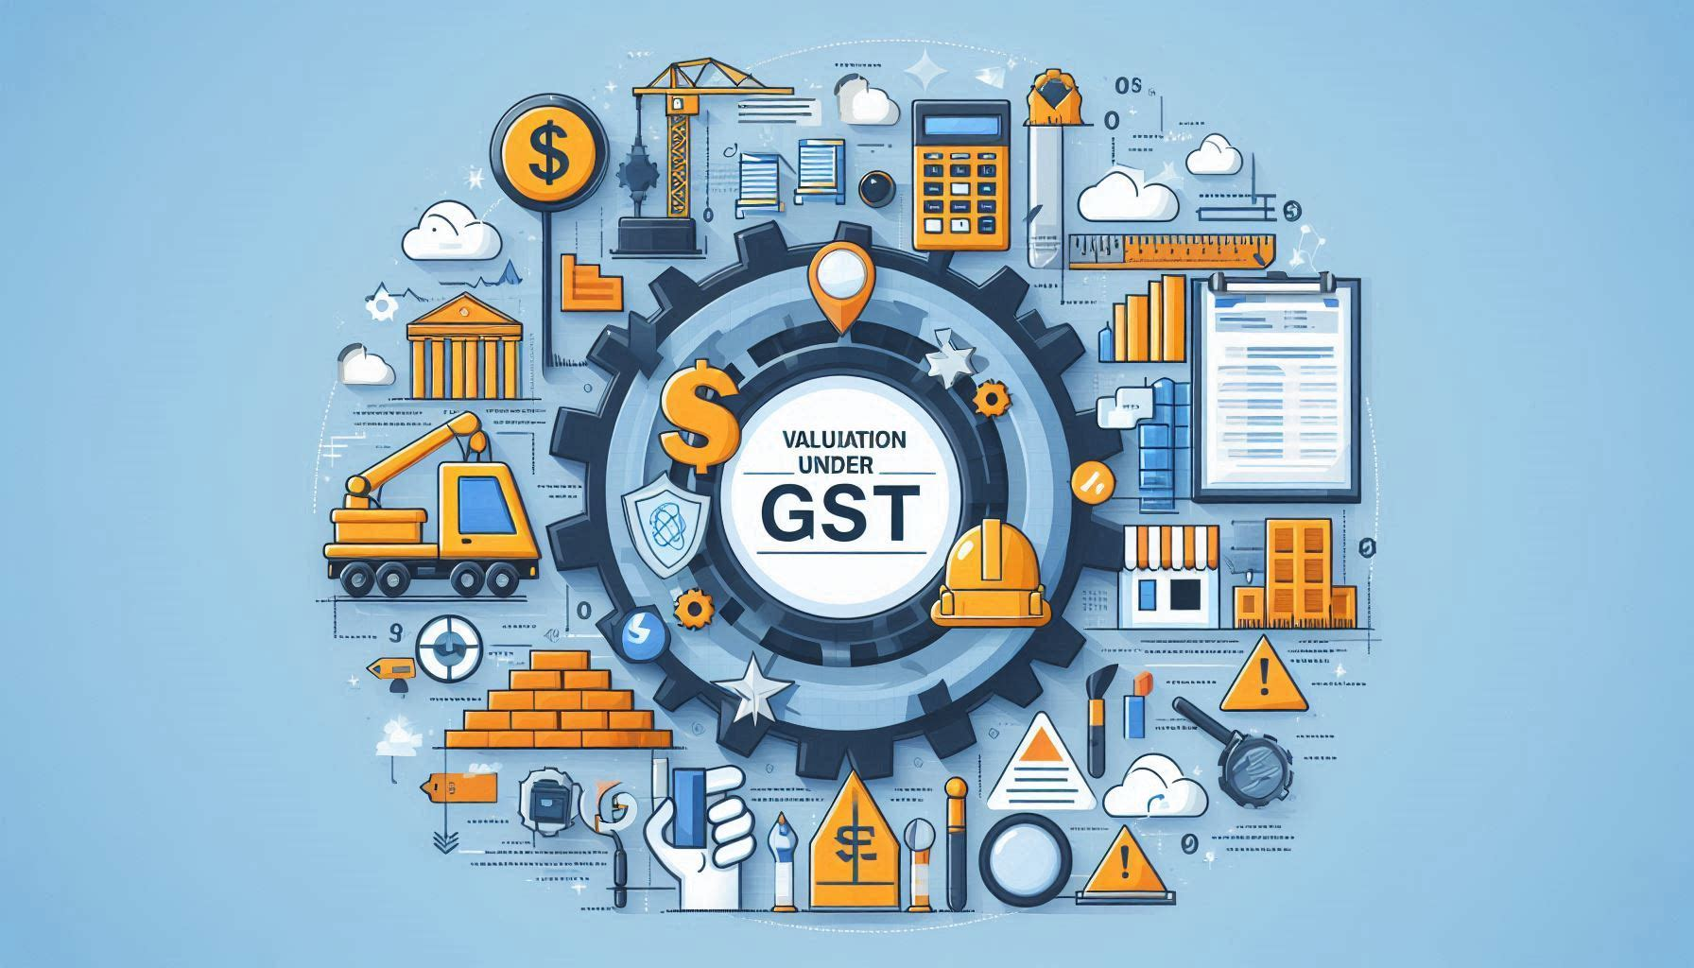
Notes:
17

Slide 18
Valuation for Construction Services
Developer pays GST on Construction Service
GST @ 18%
Developers who followed WCS and discharging GST @ 18%, excluding value of land & claiming ITC is at stake as Entry No. 3(ii) deleted.
Para 2 - 1/3rd Value of Land being Non-GST Supply (Excluded)
Value of Land is 1/3rd – Optional ???
GST is Payable only on Construction Value
An Option is available by ignoring the conditions mentioned in the NN 03/2019 – CT (R) on CS GST can be discharge @ 18%.
SC 2015 (4) TMI 643 – Wipro Ltd
GUJ – HC - 2022 (5) TMI 397 - Munjaal Manishbhai Bhatt Vs. UoI
Note:- The Developer may charge from customer GST @ 5%, however can avail ITC and pay GST @ 18%. But this opinion is highly litigious…
As GST @ 18% is paid ITC is available on the RREP or REP.

Slide 19
Valuation of Land or UDS of Land
Transfer of property in land or undivided share of land
Value of supply of service and goods portion in such supply shall be equivalent to the total amount charged for supply less the value of land or undivided share of land, and
Value of land or undivided share of land, in such supply shall be deemed to be one third of the total amount charged for such supply.
“Total Amount” means the sum total of,-
(a) consideration charged for aforesaid service; and
(b) amount charged for transfer of land or undivided share of land,
Notes:
19

Slide 20
Notes:
20

Slide 21
Input Tax Credit
In case of Ongoing Project of REP or RREP, which are commenced before 01.04.2019, accumulate ITC to be reversed after obtaining Completion Certificate.
In case of New REP, which are commenced after 01.04.2019, Common ITC & On completion of REP, ITC to be reversed after obtaining Completion Certificate.
Manner of reversal is prescribed in Rule 42 & 43

Slide 22
Sec 17(5)(c) – ITC on Works Contract
Works Contracts *
When Supplied for Construction of Immovable Property, other than P&M.
Except whose main business is Works Contract Service.
Plant & Machinery means apparatus, equipments and machinery fixed to earth which are used for Outward Supply
Includes – Foundation or Support Structure
Excludes –
Land, Building or any other Civil Structure
Telecommunication Tower
Pipelines – O/s Factory

Slide 23
Sec 17(5)(d) – G or S used for Construction of IMP
Goods or Service purchased for use in the construction
Goods or Service received by a taxable person
which are used in the construction of immovable property, other than plant and machinery,
On his Own Account including when such G or S are used for Furtherance of Business.
Construction:- [C & D]
Re-Construction, Renovation, Additions or Alterations or Repair, to the extent of Capitalization to IMP.

Slide 24
Rule 42 - Manner of Determination of ITC in respect of Inputs or Input Services used for both TS & ES
In case a RP is engaged in both Taxable & Exempted Supply, ITC in respect of Inputs & Input Services need to be reversed as per the below mentioned formula;
Determination of Eligible Credit including Common Credit used for Exempted Supply, C1 = T- (T1+T2+T3)
Determination of Common Credit, C2 = (C1- T4)
Determination of Common Credit for ES, D1= (E÷F) × C2
CC used for Other than Business Purpose, D2 = (C2 * 5%)
In Eligible ITC which need to be Reversed C3 = C2 - (D1+D2)

Slide 25
Rule 43 - Manner of Determination of ITC in respect of Capital Goods used for both TS & ES
Capital Goods exclusively used for Other than Business Purpose
Capital Goods exclusively used for Exempted Supply
Capital Goods not covered above is denoted as “A”
Capital Goods commonly used for both TS & ES denoted as “Tc”
Amount of ITC attributable to a Tax Period is denoted as “Tm”, Tm = (Tc / 60)
Aggregate of various Tm is referred as Tr
Common Credit Te = E/F* Tr
In case of REP or RREP, “E” or “F” shall be carpet area and calculated at the end of project.

Slide 26
Joint Development Agreement
Joint Development Agreements (JDAs) in the real estate sector are crucial for collaboration between landowners and developers. There are generally two main types of JDAs:
Area Sharing Agreement: In this type of JDA, the landowner contributes the land, and the developer takes on the responsibility of obtaining approvals, constructing the project, and handling sales and marketing.
Revenue Sharing Agreement: Similar to the Area Sharing Agreement, the landowner provides the land, while the developer manages the development process. However, instead of receiving a portion of the saleable area, the landowner gets a share of the revenue generated from the project.

Slide 27
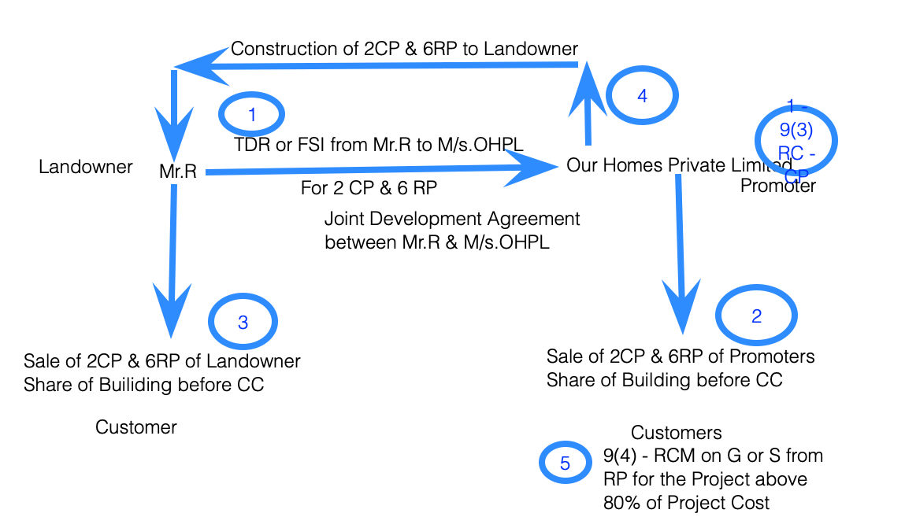
Joint Development Agreement – Area Sharing

Slide 28
Joint Development Agreement – Revenue Sharing
In the case of a Revenue Sharing JDA, the revenue from the sale of the plots or flats is shared between the landowner and the developer in a pre-agreed ratio.
For example, if the agreed ratio is 60% for the landowner and 40% for the developer, and the total revenue from the Sale is ₹100,000, the landowner would receive ₹60,000, and the developer would receive ₹40,000. This sharing of revenue is after the completion of the development and the sale of the plots or units.

Slide 29
RCM on Construction Services under GST

Slide 30
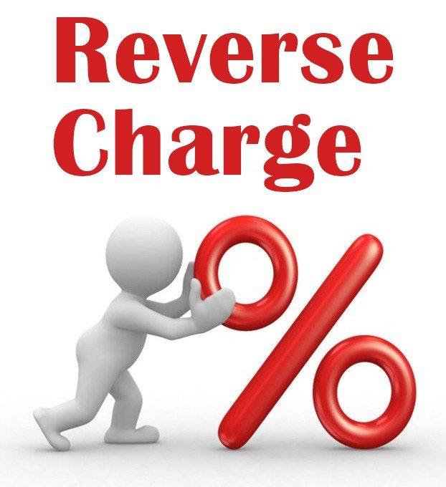
Sec 9(4) - RCM on REP & RREP by Promoter
Noti. No. 07/2019 – CT (Rate) - Entry No. 1 to 3 - Sec 9(4) of CGST
Supply of Goods or Services in Shortfall from the minimum value of Goods or Services required to be purchased for construction of a Project.
Cement Purchased from Un-Registered Person.
Capital Goods Purchased by Un-Registered Person.
Tax shall be paid by Promoter of RREP or REP.
% of GST Payable by
SP – Nil SR – 100%

Slide 31
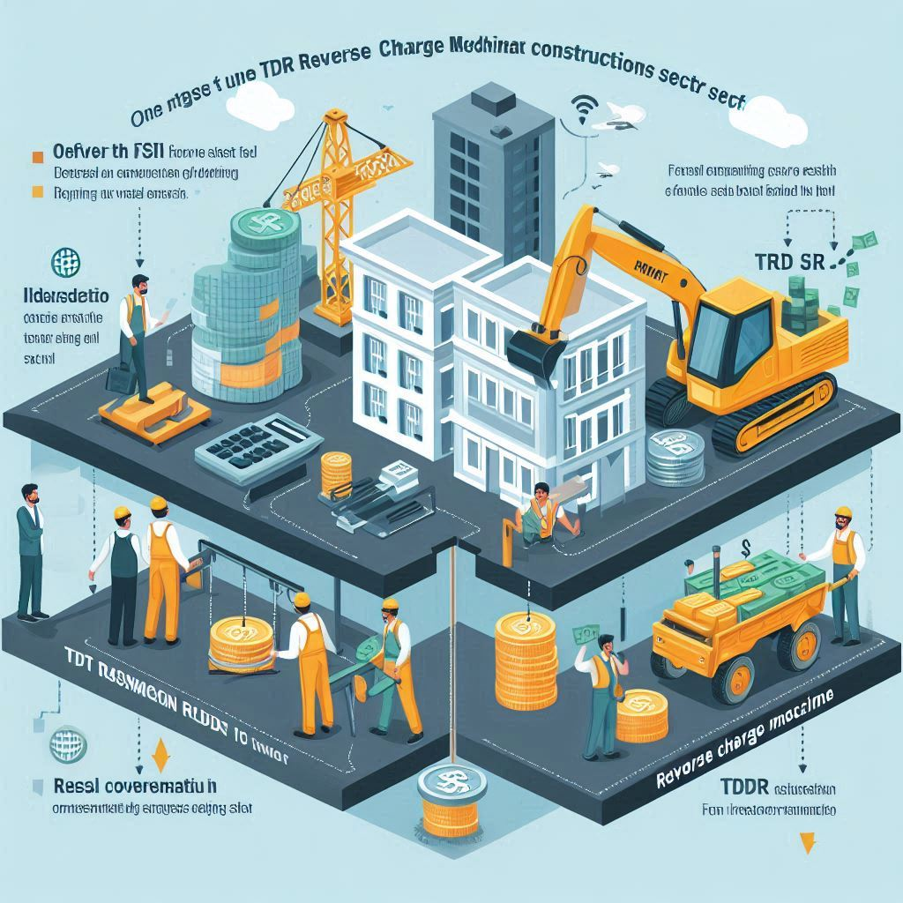
Service by TDR or FSI or LTL for Construction
Nature of Supply
Services supplied by any person by way of Transfer of Development Rights (TDR) or Floor Space Index (FSI) or Long Term Lease of Land for construction of project by a Promoter.
Recipient of Service
Promoter
Promoter means as per RERA Act, 2016

Slide 32
Exemption on Construction Services under GST

Slide 33
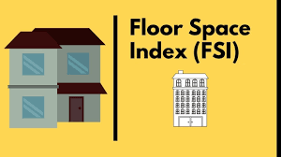
Exemption – Transfer of Development Rights
Services by way of TDR or Floor Space Index or by way of Long Term Lease on or after 01-04-2019 for Construction of Residential Apartments by promoter in a project intended for sale to a buyer wholly or partly, if all the flats are sold in the project by the promoter before issuance of Completion Certificate or after its 1st occupation whichever is earlier.
The promoter shall be liable to pay tax at the applicable rate, on reverse charge basis, such proportion of value of development rights, or FSI, or both, as is attributable to the residential apartments, which remain un-booked on the date of issuance of completion certificate, or 1st occupation of the project.
Notes:
33

Slide 34
S.No 10 – Pure Labour Contracts of Construction (PAMY)
Services provided by way of pure labour contracts of construction, erection, commissioning, installation, completion, repair & renovation;
Any other works pertaining to the Beneficiary led individual (EWS & LIG) house construction or enhancement under the
Housing for All (Urban) Mission
Pradhan Mantri Awas Yojana (PMAY)
Notes:
34

Slide 35
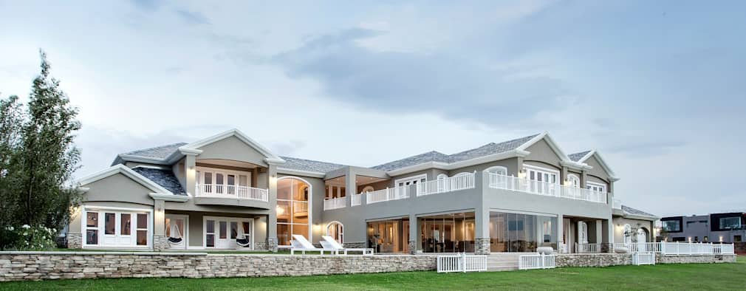
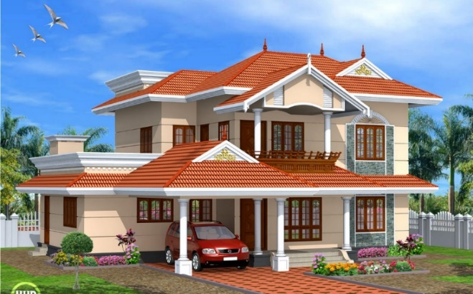
S.No 11 – Pure Labour pertaining to Single Residential Unit
Service by way of pure labour contracts of
Construction, Erection, Commissioning or Installation of original works pertaining to a residential unit otherwise than as a part of a residential complex.
“Residential complex” means any complex comprising of a building or buildings, having more than one single residential unit;
Notes:
35

Slide 36
CA Ganesh Prabhu Balakumar
Practice Leader – GST & Indirect Tax Team
C R B S & Associates LLP, Chartered Accountants
Mobile: +91 98404 71139
E- Mail : ganeshprabhu.b@gmail.com
Disclaimer: The author of this presentation makes no warrant, and expressly disclaim any obligation, that; (a) the information contained therein will be complete, accurate, or up to date; (b) the results obtained from the use of such information will be accurate or reliable; (c) the quality of such information will meet the users expectation’s. The author is not responsible or liable for any loss, claim, delay or damages of any kind that may arise out of or in connected with use of such information. The author expressly disclaims for any act or omission, or any consequences of any act or omission by any user relaying on information provided in this document or interpretation thereof. © 2023 CA Ganesh Prabhu Balakumar

